Slide 1


Fundamentals of microprocessor and embedded system
AMERICAN INTERNATIONAL UNIVERSITY – BANGLADESH(AIUB)
Where leaders are created
Course teacher: Protik parvez sheikh

Slide 2
Marking system For Lab Classes (Midterm)
Attendance | 10%
Lab report | 30%
OEL performance + OEL report | 20%
Lab quiz | 20%
Proposal form of a project + Survey to develop a process for complex engineering problems considering cultural and societal factors | 15+5=20%
Total | 100%
Marking system For Lab Classes (Final term)
Attendance | 10%
Lab report | 20%
Lab quiz | 20%
Project presentation | 10%
Open-Ended Laboratory (OEL)+ OEL report | 10%
Rest of the Project report | 25%
Literature review for investigating the design of experiments for complex engineering problems through appropriate research. | 5%
Total | 100%
Marking system For Theory Classes (Midterm and Final term)
Attendance | 10%
Assignment 1 | 10%
Quiz | 20%
Assignment 2 | 20%
Midterm/Final Exam | 40%
Total | 100%

Slide 3
Introduction to Microprocessors
What is a Microprocessor?
A microprocessor is a computer processor where the data processing logic and control is included on a single integrated circuit.
The microprocessor contains the arithmetic, logic, and control circuitry required to perform the functions of a computer's central processing unit.
The microprocessor is a multipurpose, clock-driven, register-based, digital integrated circuit that accepts binary data as input, processes it according to instructions stored in its memory, and provides results (also in binary form) as output.

Slide 4
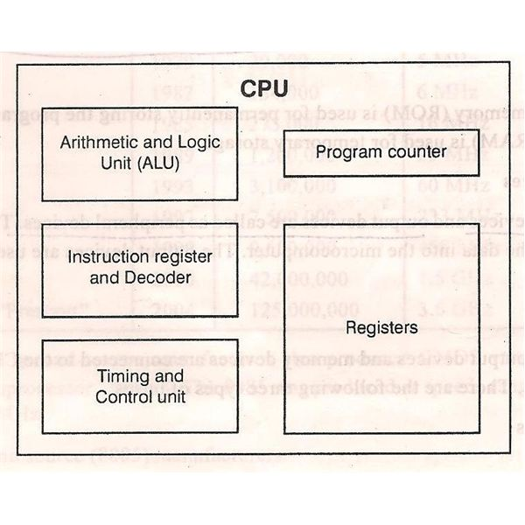
BASIC PARTS OF A MICROPROCESSOR
Arithmetic and Logic Unit: It is the computational unit of microprocessor. It performs arithmetic and logical operations.
Registers: Registers may be called as the Internal Storage device. Input data, Output data and various other binary data is stored in this unit for further processing.
Control Unit: Control unit as the name specifies controls the flow of data and signals in the microprocessor. It generates the necessary control signals for various data that are fed to microprocessor.
Instruction Register: All the instructions that are fetched from memory are located in the Instruction register. So the Instruction register is used to store various information that microprocessor requires in order to carry out an operation.
Program Counter (PC): Program counter stores the address of the next instruction to be executed. It is usually denoted as PC.

Slide 5
WHAT IS A MICROCONTROLLER?
A microcontroller also called MCUs or Microcontroller Unit is a single integrated circuit (IC) that is used for a specific application and designed to implement certain tasks.
Products and devices that have been automatically controlled in certain situations, like appliances, power tools, automobile engine control systems, medical equipment, high-end consumer electronics, rugged industrial devices, and computers are great examples, but microcontrollers reach much higher than these applications.
Essentially, a microcontroller works to gather input, process the information, and output a particular action based on the information gathered.
Microcontrollers or MCUs can operate at lower speeds, for example, it can operate at around in 1MHz to 200 MHz of range, and is designed to consume less power because they’re embedded inside the other devices, which have greater power consumptions in other areas.

Slide 6
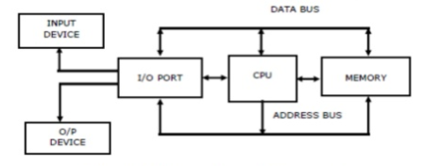
OVERVIEW OF MICROCOMPUTER STRUCTURE AND OPERATION
1. CPU: It controls the operation of computer. The CPU fetches binary-coded instructions from memory. Decodes the instructions into a series of simple actions. Carries out these actions in a sequence of steps.
2. Memory: It stores the binary codes for the sequences of instructions in binary coded data format. Example: ROM, RAM, magnetic / optical disks
3. Input / Output circuitry: They are used to take in data from outside world or send data to the outside world. I/O devices are connected with microprocessor through I/O ports. Example: Keyboards, video display terminals, printers, modems .
3. Buses: A bus is a high-speed internal connection. Buses are used to send control signals and data between the processor and other components. Three types of bus are used: Address bus, data bus, control bus.
a) Address bus - carries memory addresses from the processor to other components such as primary storage and input/output devices. The address bus is unidirectional.
b) Data bus - carries the data between the processor and other components. The data bus is bidirectional.
c) Control bus - carries control signals from the processor to other components. The control bus also carries the clock's pulses. The control bus is unidirectional.

Slide 7
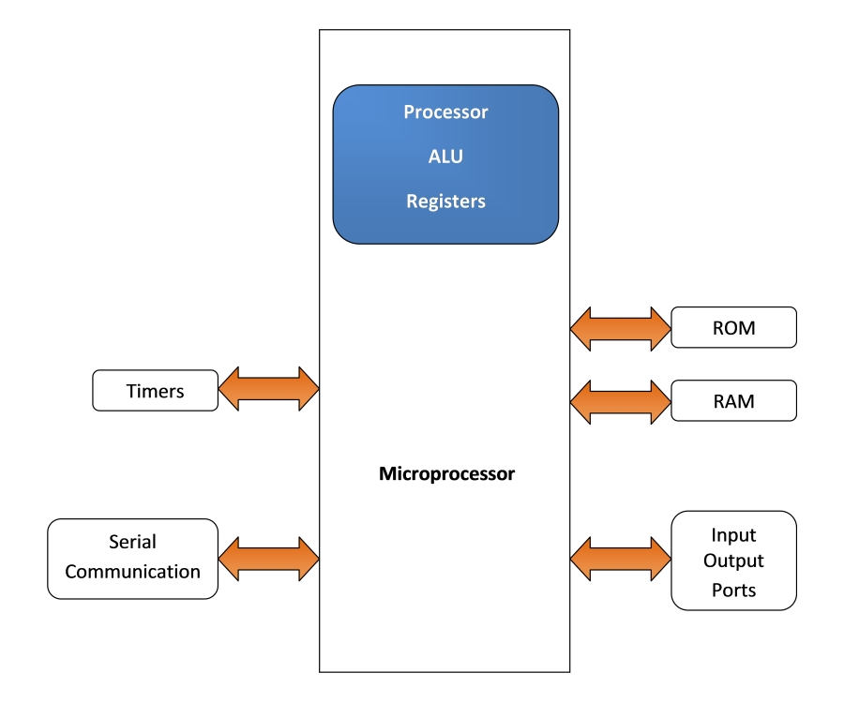
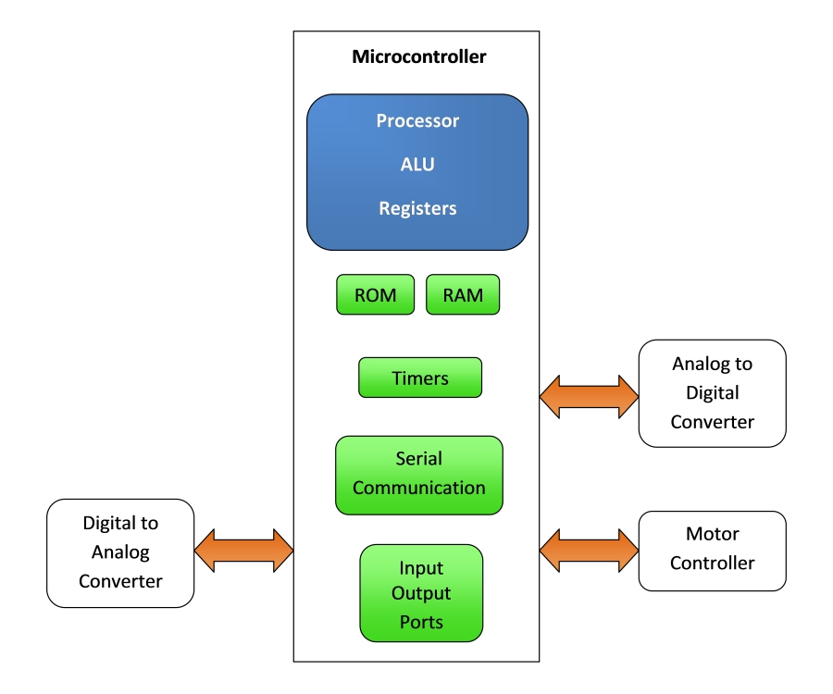
Microprocessor vs. Microcontroller
Microprocessor
Microcontroller

Slide 8
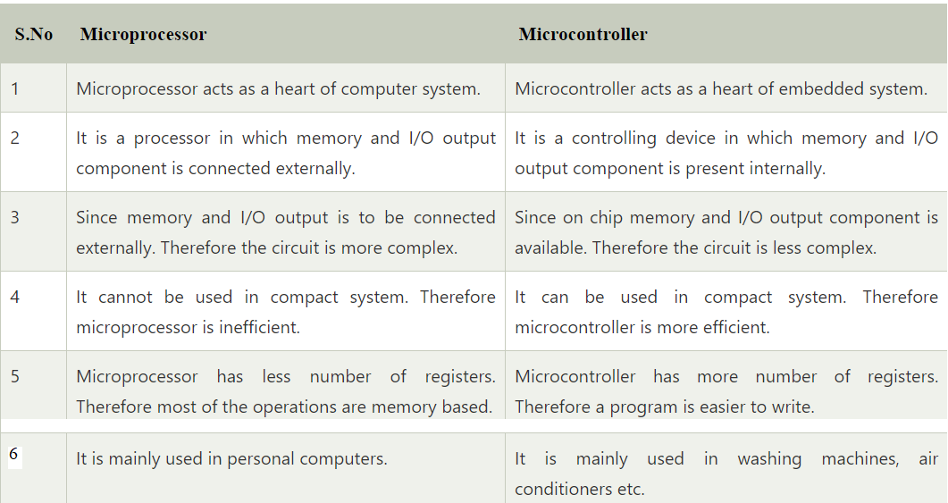
Microprocessor vs. Microcontroller
Notes:
More differences required

Slide 9
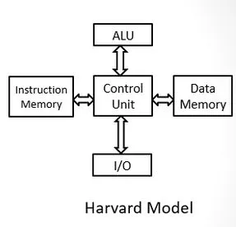
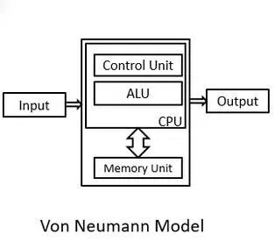
Harvard ARCHITECTURE VS VON NEUMANN ARCHITECTURE
Point of Comparison | Harvard Architecture | Von Neumann Architecture
Arrangement | In Harvard architecture, the CPU is connected with both the data memory (RAM) and program memory (ROM), separately. Some of the earlier microcontrollers used this architectures. | In Von-Neumann architecture, there is no separate data and program memory. Instead, a single memory connection is given to the CPU. Some of the earlier microprocessors used this architecture.
Hardware requirements | It requires more hardware since it will be requiring separate data and address bus for each memory. | In contrast to the Harvard architecture, this requires less hardware since only a common memory needs to be reached.

Slide 10
Harvard ARCHITECTURE VS VON NEUMANN ARCHITECTURE
Point of Comparison | Harvard Architecture | Von Neumann Architecture
Space requirements | This requires more space. | Von-Neumann Architecture requires less space.
Speed of execution | Speed of execution is faster because the processor fetches data and instructions simultaneously . | Speed of execution is slower since it cannot fetch the data and instructions at the same time.
Space usage | It results in wastage of space since if the space is left in the data memory then the instructions memory cannot use the space of the data memory and vice-versa. | Space is not wasted because the space of the data memory can be utilized by the instructions memory and vice-versa.
Controlling | Controlling becomes complex since data and instructions are to be fetched simultaneously. | Controlling becomes simpler since either data or instructions are to be fetched at a time.

Slide 11
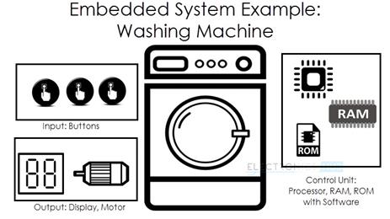
What is an Embedded System?
An Embedded System can be best described as a system which has both the hardware and software and is designed to do a specific task.
It should be noted that embedded systems may only have some specific range of operations or, it can be programmed to performed a wide-range of tasks.
A good example for an Embedded System, which many households have, is a Washing Machine.
We use washing machines almost daily but wouldn’t get the idea that it is an embedded system consisting of a Processor (and other hardware as well) and software.

Slide 12
What is an Embedded System? (Contd.)
Embedded Systems can not only be stand-alone devices like Washing Machines but also be a part of a much larger system. An example for this is a Car. A modern day car has several individual embedded systems that perform their specific tasks with the aim of making a smooth and safe journey.
Some of the embedded systems in a Car are Anti-lock Braking System (ABS), Temperature Monitoring System, Automatic Climate Control, Tyre Pressure Monitoring System, Engine Oil Level Monitor, etc.

Slide 13
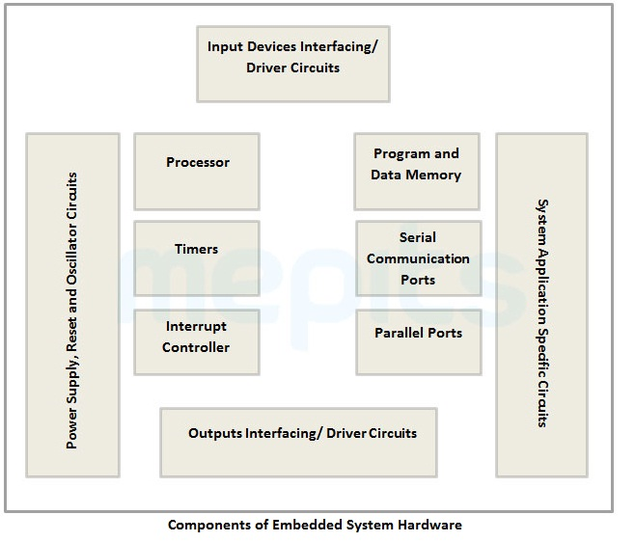

Embedded system
An embedded system is a microprocessor-based computer hardware system with software that is designed to perform a dedicated function, either as an independent system or as a part of a large system. At the core is an integrated circuit designed to carry out computation for real-time operations.

Slide 14
Embedded system
An embedded System can be best described as a system that has both the hardware and software and is designed to do a specific task. Embedded systems may only have some specific range of operations and can be programmed to perform a wide range of tasks.
The Internet of Things (IoT) refers to physical objects equipped with sensors, processing ability, software, and other technologies that connect to and exchange data with other devices and systems over communication networks. The devices in IoT do not need to be connected to the public internet; rather must be connected to a network and be individually addressable.

Slide 15
Classifications of embedded systems:
Based on Performance and Functional Requirements it is divided into 4 types as follows :
1. Real-Time Embedded Systems :
A Real-Time Embedded System is strictly time specific which means these embedded systems provides output in a particular/defined time interval. These type of embedded systems provide quick response in critical situations which gives most priority to time based task performance and generation of output. That’s why real time embedded systems are used in defense sector, medical and health care sector, and some other industrial applications where output in the right time is given more importance.
Examples :Traffic control system, Military usage in defense sector, Medical usage in health sector
2. Stand Alone Embedded Systems :
Stand Alone Embedded Systems are independent systems which can work by themselves they don’t depend on a host system. It takes input in digital or analog form and provides the output.
Examples : MP3 players, Microwave ovens, calculator

Slide 16
Classifications of embedded systems:
3. Networked Embedded Systems :
Networked Embedded Systems are connected to a network which may be wired or wireless to provide output to the attached device. They communicate with embedded web server through network.
Examples : Home security systems, ATM machine, Card swipe machine
4. Mobile Embedded Systems :
Mobile embedded systems are small and easy to use and requires less resources. They are the most preferred embedded systems. In portability point of view mobile embedded systems are also best.
Examples : Mobile phones, Digital Camera

Slide 17
Classifications of embedded systems:
Based on Performance and micro-controller it is divided into 3 types as follows :
Small-scale embedded system: they are designed using an 8-bit or 16-bit micro-controller. They can be powered by a battery. The processor uses very less/limited resources of memory and processing speed. Mainly these systems does not act as an independent system they act as any component of computer system but they did not compute and dedicated for a specific task.
Medium-scale embedded system: they are designed using an 16-bit or 32-bit micro-controller. These medium Scale Embedded Systems are faster than that of small Scale Embedded Systems. Integration of hardware and software is complex in these systems. Java, C, C++ are the programming languages used to develop medium scale embedded systems. Different type of software tools like compiler, debugger, simulator etc are used to develop these type of systems.
Sophisticated embedded systems: they are designed using multiple 32-bit or 64-bit micro-controller. These systems are developed to perform large scale complex functions. These systems have high hardware and software complexities. We use both hardware and software components to design final systems or hardware products.

Slide 18
New hardware Options emerged for embedded systems areas follows:
At present, some of the popular microcontroller families in the market are:
ATMega family: ATMega328P, ATMega32
Pic-chips: Pic24, Pic33 etc
ARM processors: Raspberry Pi, TM4C chips, STM32 F401
In Bangladesh, ATMega based Arduino boards have gained wide popularity due to easy availability and low price
We are going to mostly focus on the ATMega328P chip during midterm and then on the Arm processors in final term.

Slide 19
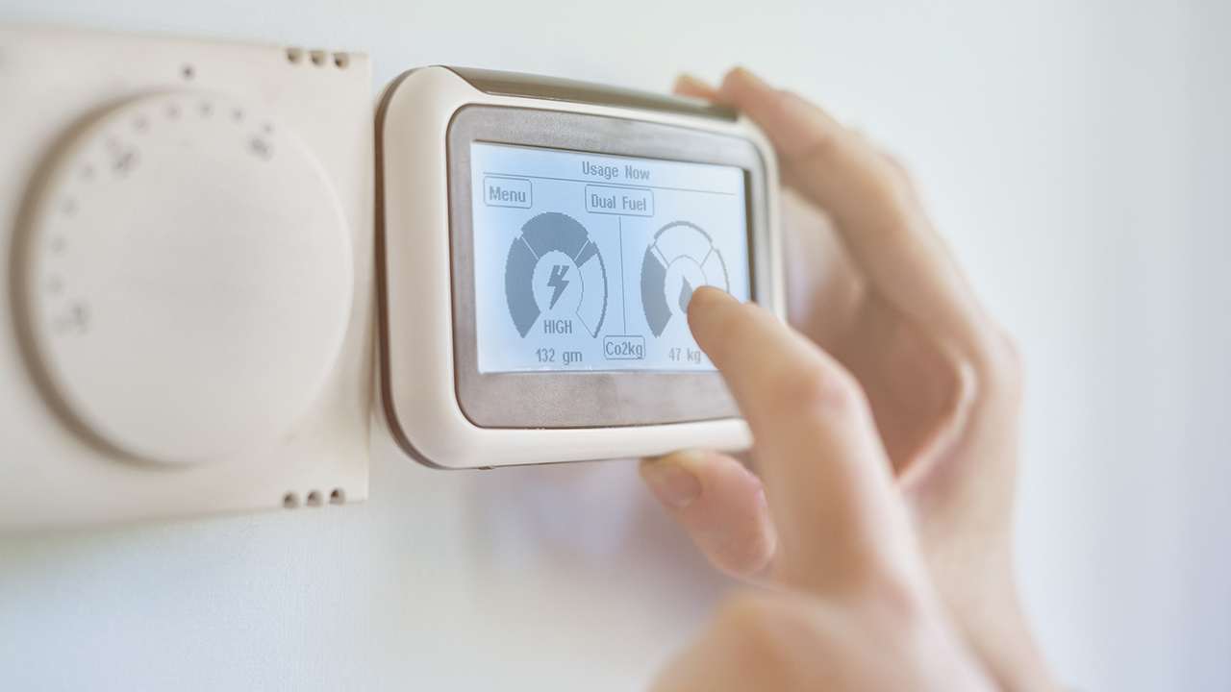
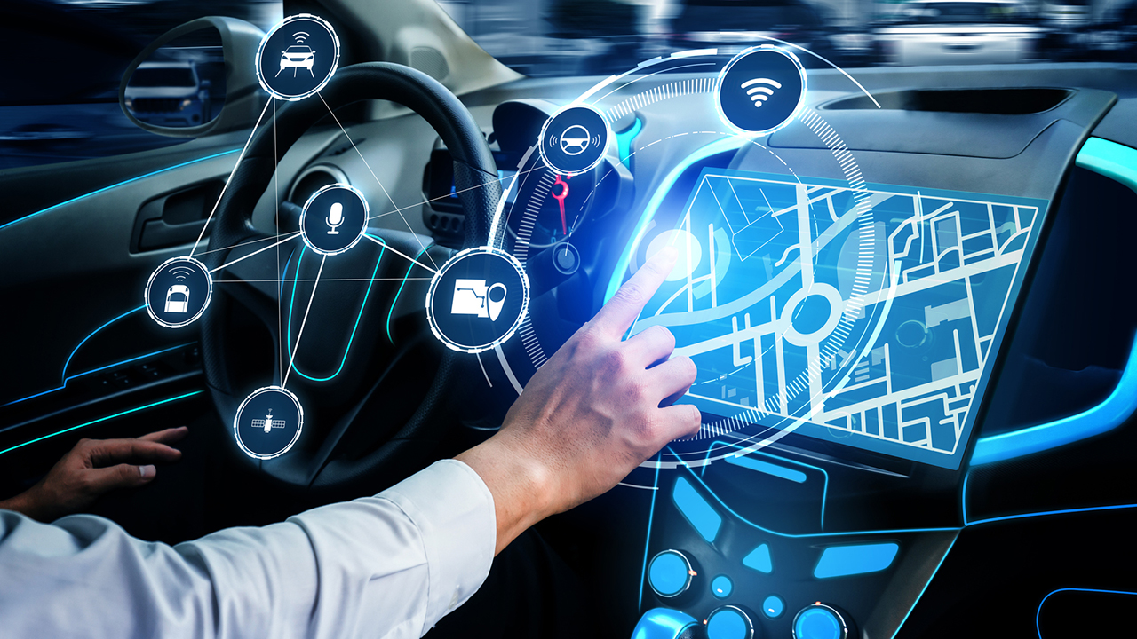

Real-life Examples of embedded systems:
Exceptionally versatile and adaptable, embedded systems can be found in all smart devices today. It is difficult to find a single portion of modern life that doesn’t involve this technology. Here are some of the real-life examples of embedded system applications.
Central heating systems GPS systems Fitness trackers

Slide 20
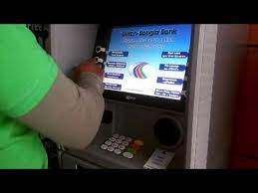
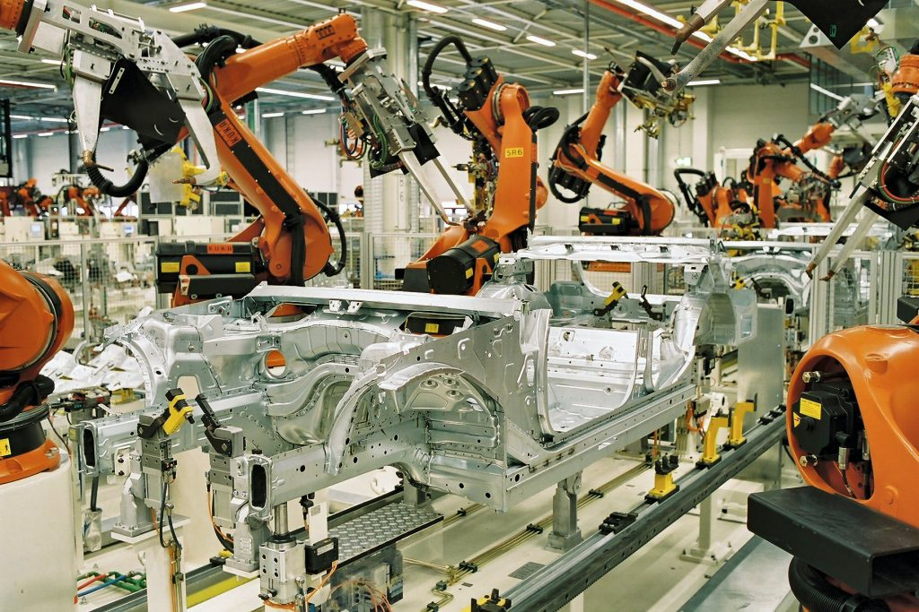
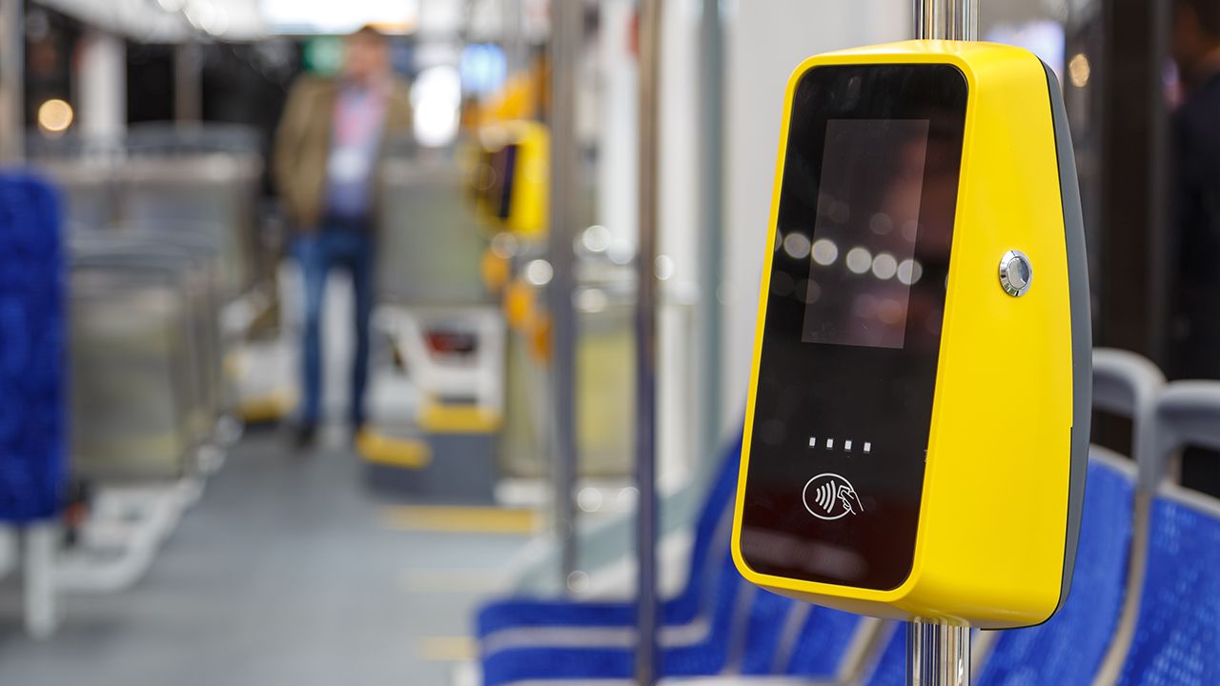
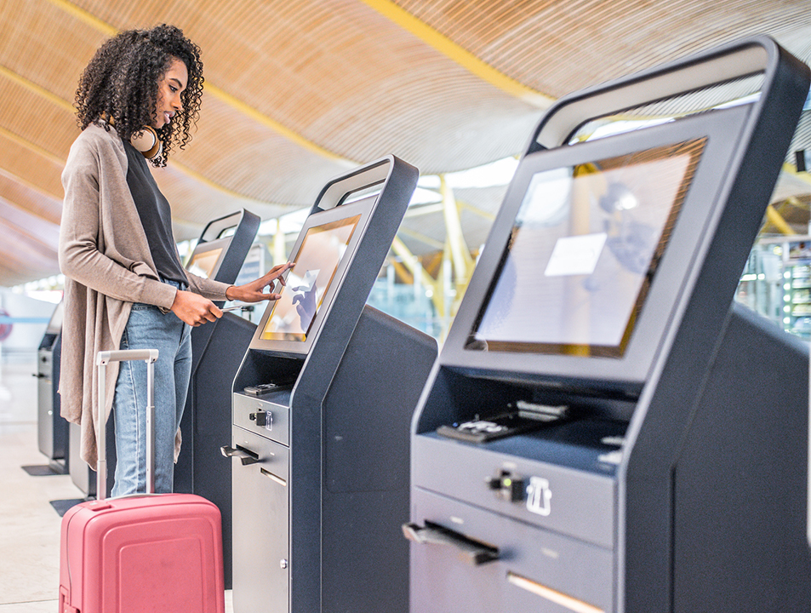
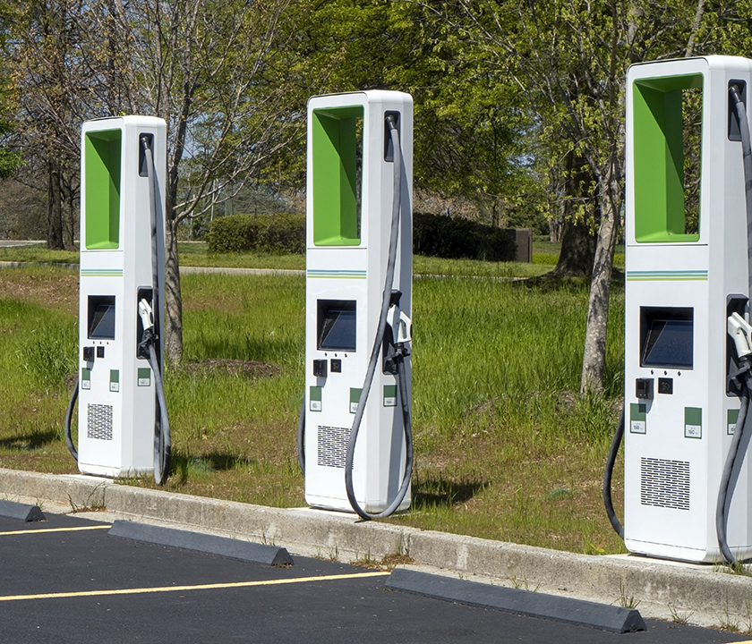
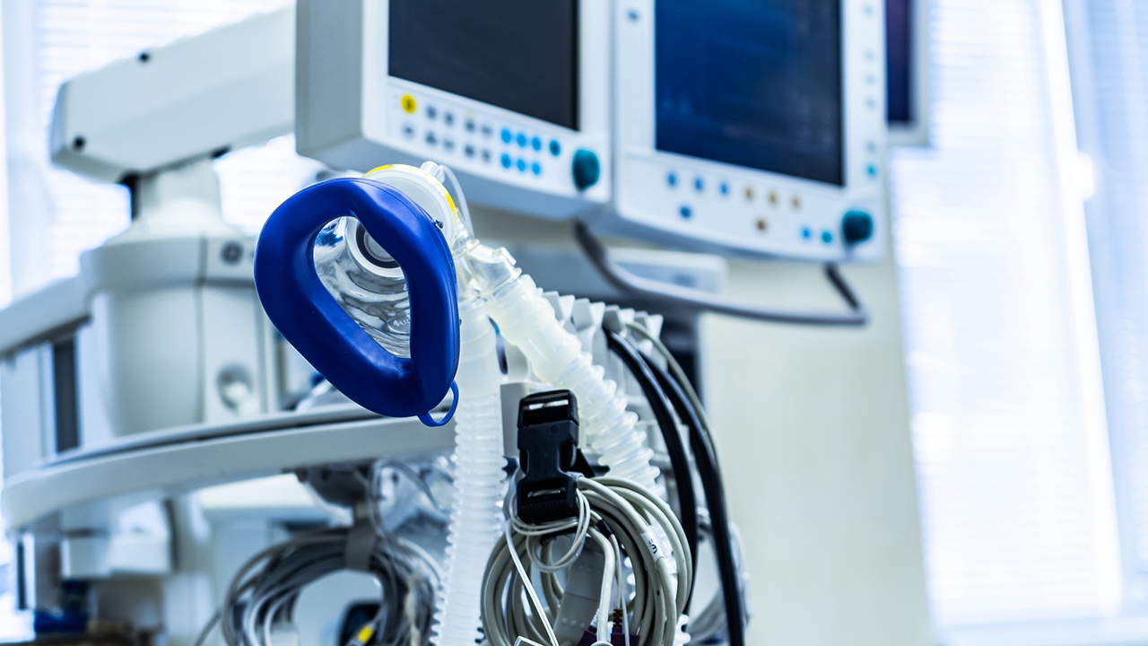
Real-life Examples of embedded systems:
Automatic fare collection(AFC) ATM systems Factory robots
Medical devices Self-service kiosks Electric vehicle charging stations

Slide 21

References:
Embedded Systems and Robotics with Open Source Tools By Nilanjan Dey, Amartya Mukherjee
Embedded System Design with ARM Cortex-M Microcontrollers: Applications with C, C++ and MicroPython by Cem Unsalan
https://www.digi.com/blog/post/examples-of-embedded-systems

